Slide 1
Vitaliya Stankuviene
Impact
Purpose
Growth
Authenticity
Faith
Adventure
Excellence
Grit

Slide 2
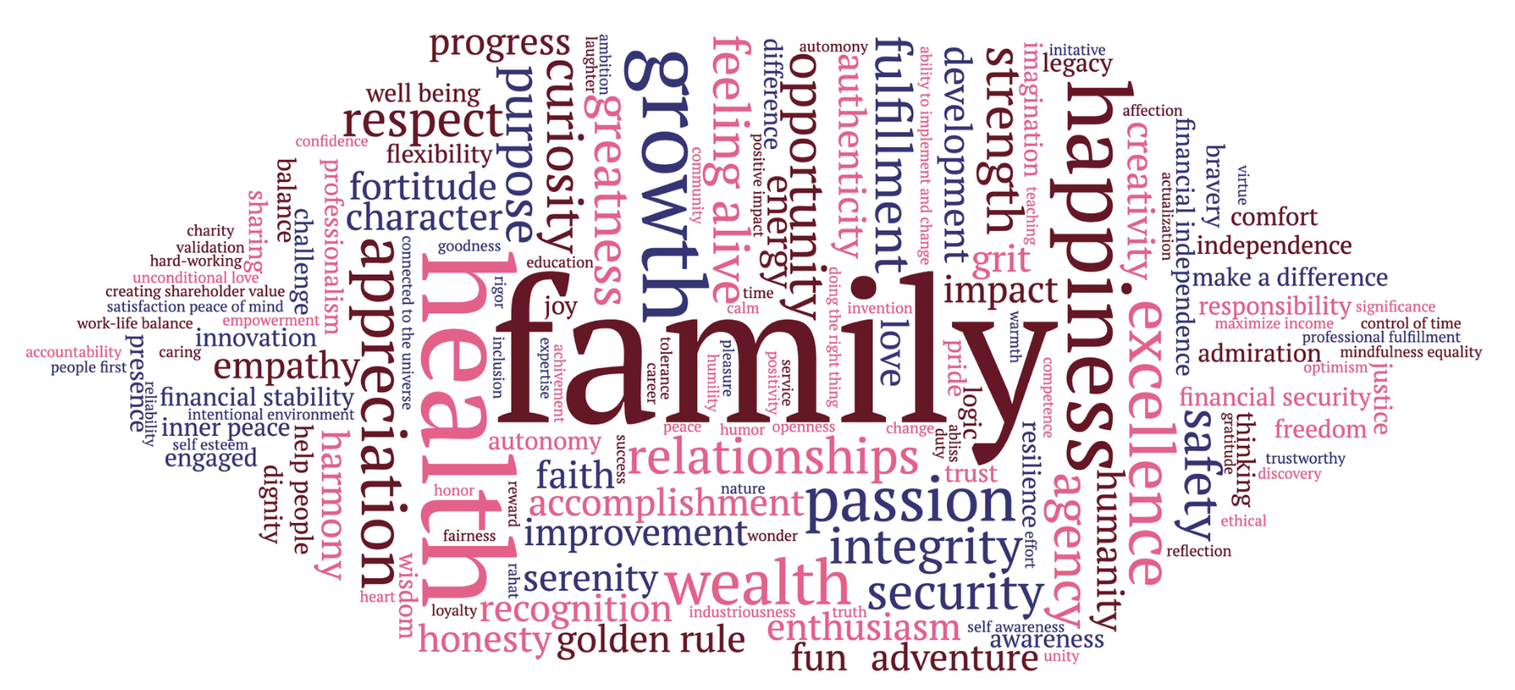

Slide 3
Elizabeth Agyemang
Faith
Inner
Peace
Industriousness
Family
Communication
Comfort
Fortitude
Imagination

Slide 5
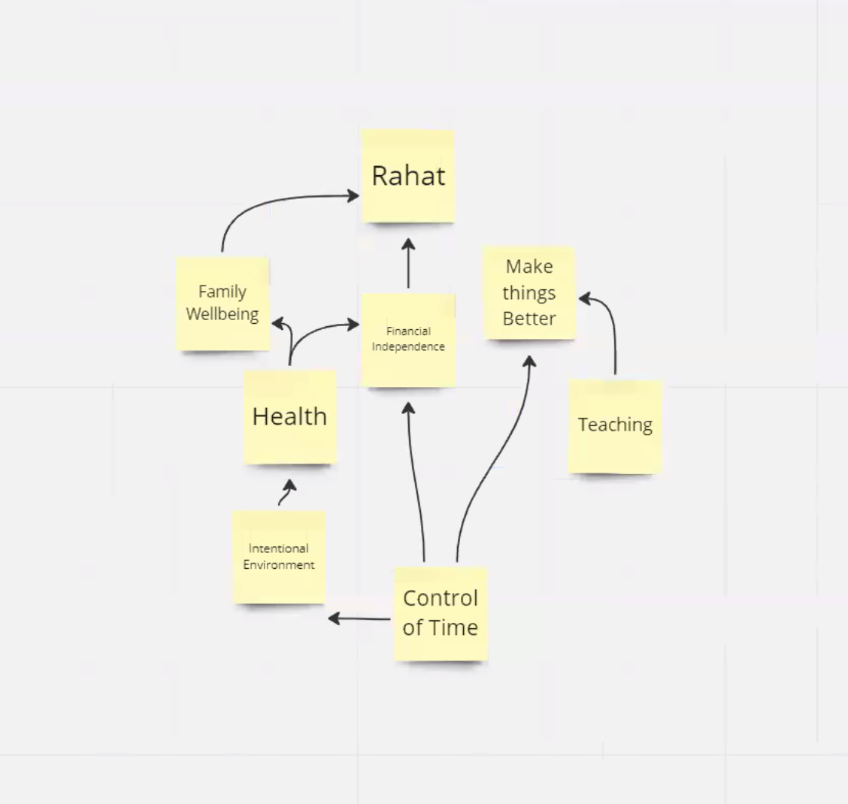
Daniel Ahmadizadeh

Slide 7
Jonathan Alvear

Slide 9
Xuguang Chen
Health
Pride
Family
Difference
Wealth
Recognition
Development
Logic

Slide 11
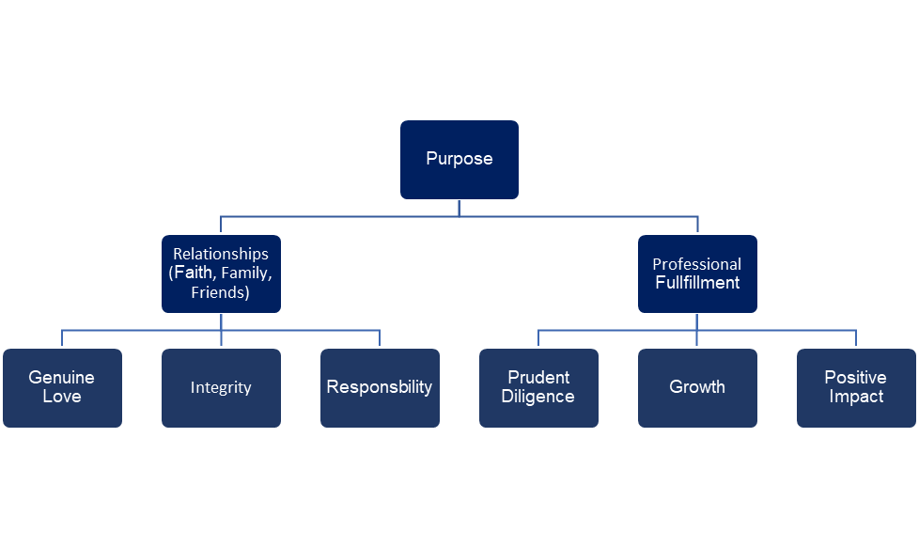
Adam Coombs

Slide 13
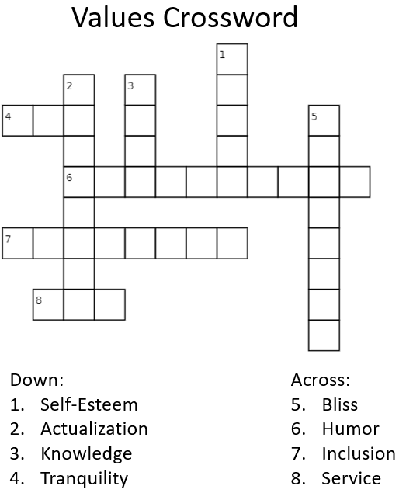
Jean-Franco Diaz

Slide 15
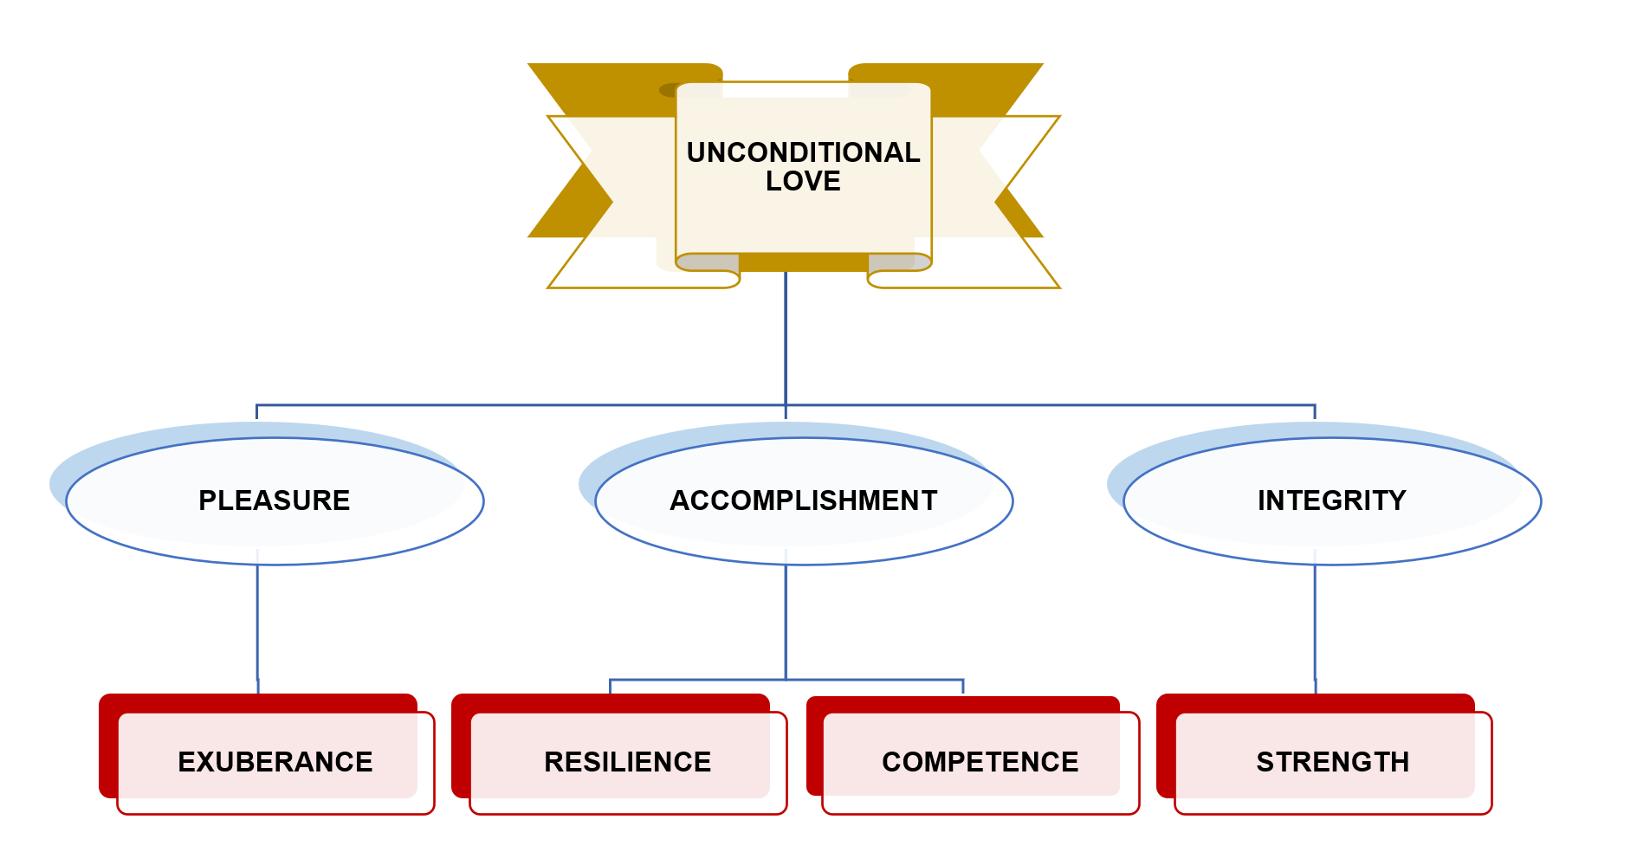
Kathleen Durongpisitkul

Slide 17
John Faso
Greatness
Progress
Satisfaction
……….
………….
Accountability
Flexibility
Job Effeteness

Slide 19
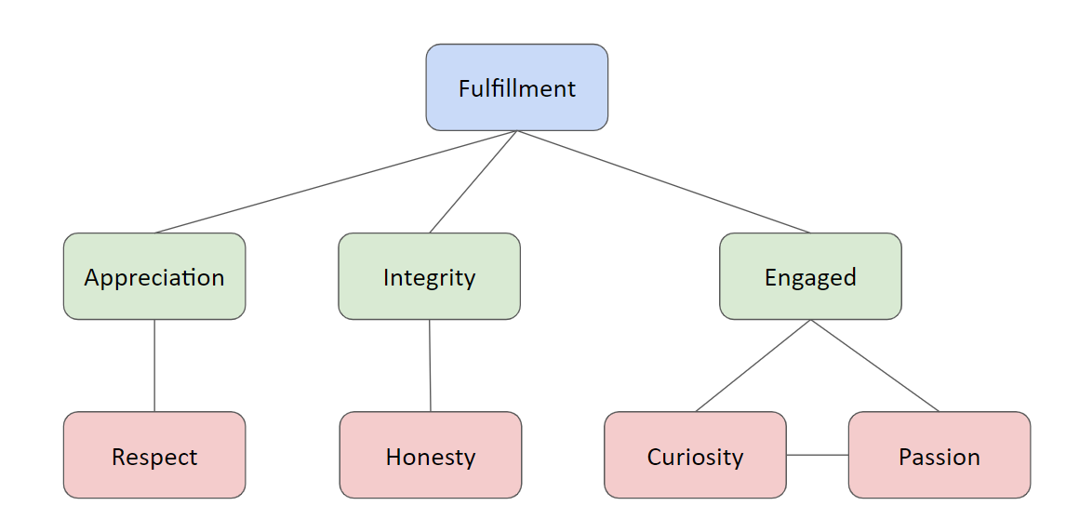
Michael Foley

Slide 21
Jun Fujita
Love
Affection
Fun
Honor
Recognition
Accomplishment
Passion
Expertise

Slide 23
Nan Girard
Impact
Empathy
Balance Family
Work/ Life
Authenticity
Appreciation
Financial
Independence
Growth
Invention

Slide 25
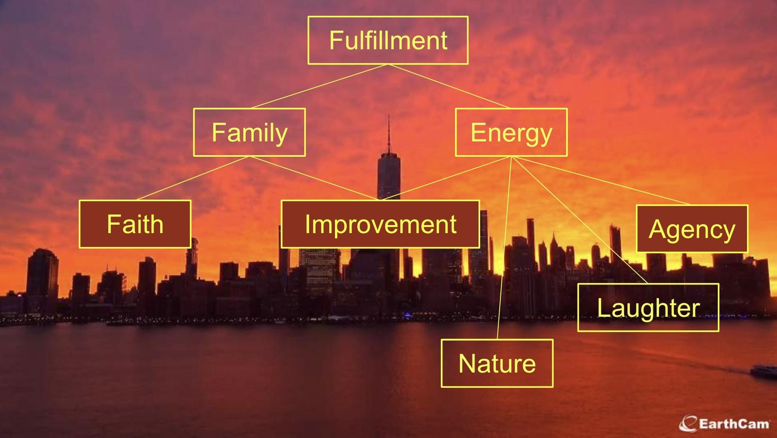
Evgenia Gorovaya

Slide 27
Russell Grant
Calm
Organization
Duty
Fortitude
Pride
Effort
Change
Challenge

Slide 29
Meris Hoxha
Family
Greatness
Harmony
Moral Courage
Legacy
Wisdom
Bravery
Wealth

Slide 31
Beatrice Kao
Relationship
Responsibility
Respect
Growth
Balance
Freedom
Empathy
Happiness

Slide 33
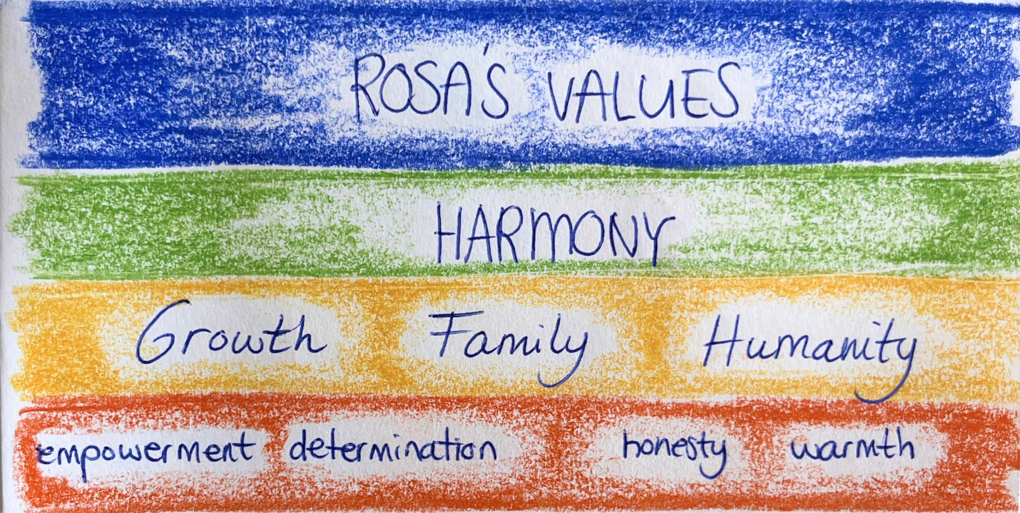
Rosa Catharina Keizer

Slide 35
Pranav Krishnan
Serenity
Gratitude
Wealth
Unity
Character
Excellence
Thoughtful Listening
Compassion

Slide 37
Charlotte Kwon
Growth
Awareness
Agency
Ethical
Difference
Golden Rule
Comfort
Well
Being

Slide 39
Jacob Lauer
Love
People First
Integrity
Excellence
Charity
Humility
Virtue
Seriousness of The Mind

Slide 41
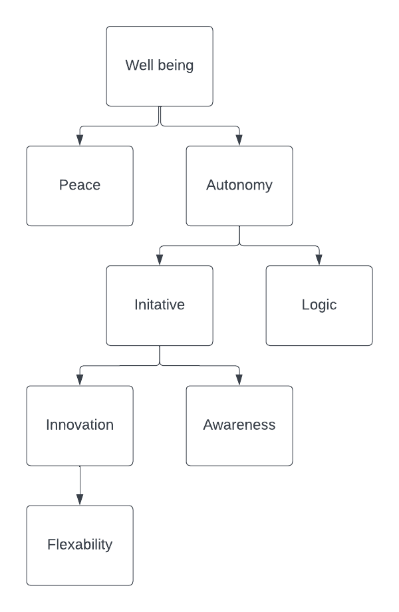
Aaron Levin

Slide 43
Reeti Gupta
Security
Safety
Family
Engaged
Presence
……..
Education
Enthusiasm
Motivation

Slide 45
Jay Dixon
Joy
Help People
Feeling Alive
Empty
Openness
Family
Connected
To The
Universe
Do The Right Thing

Slide 47
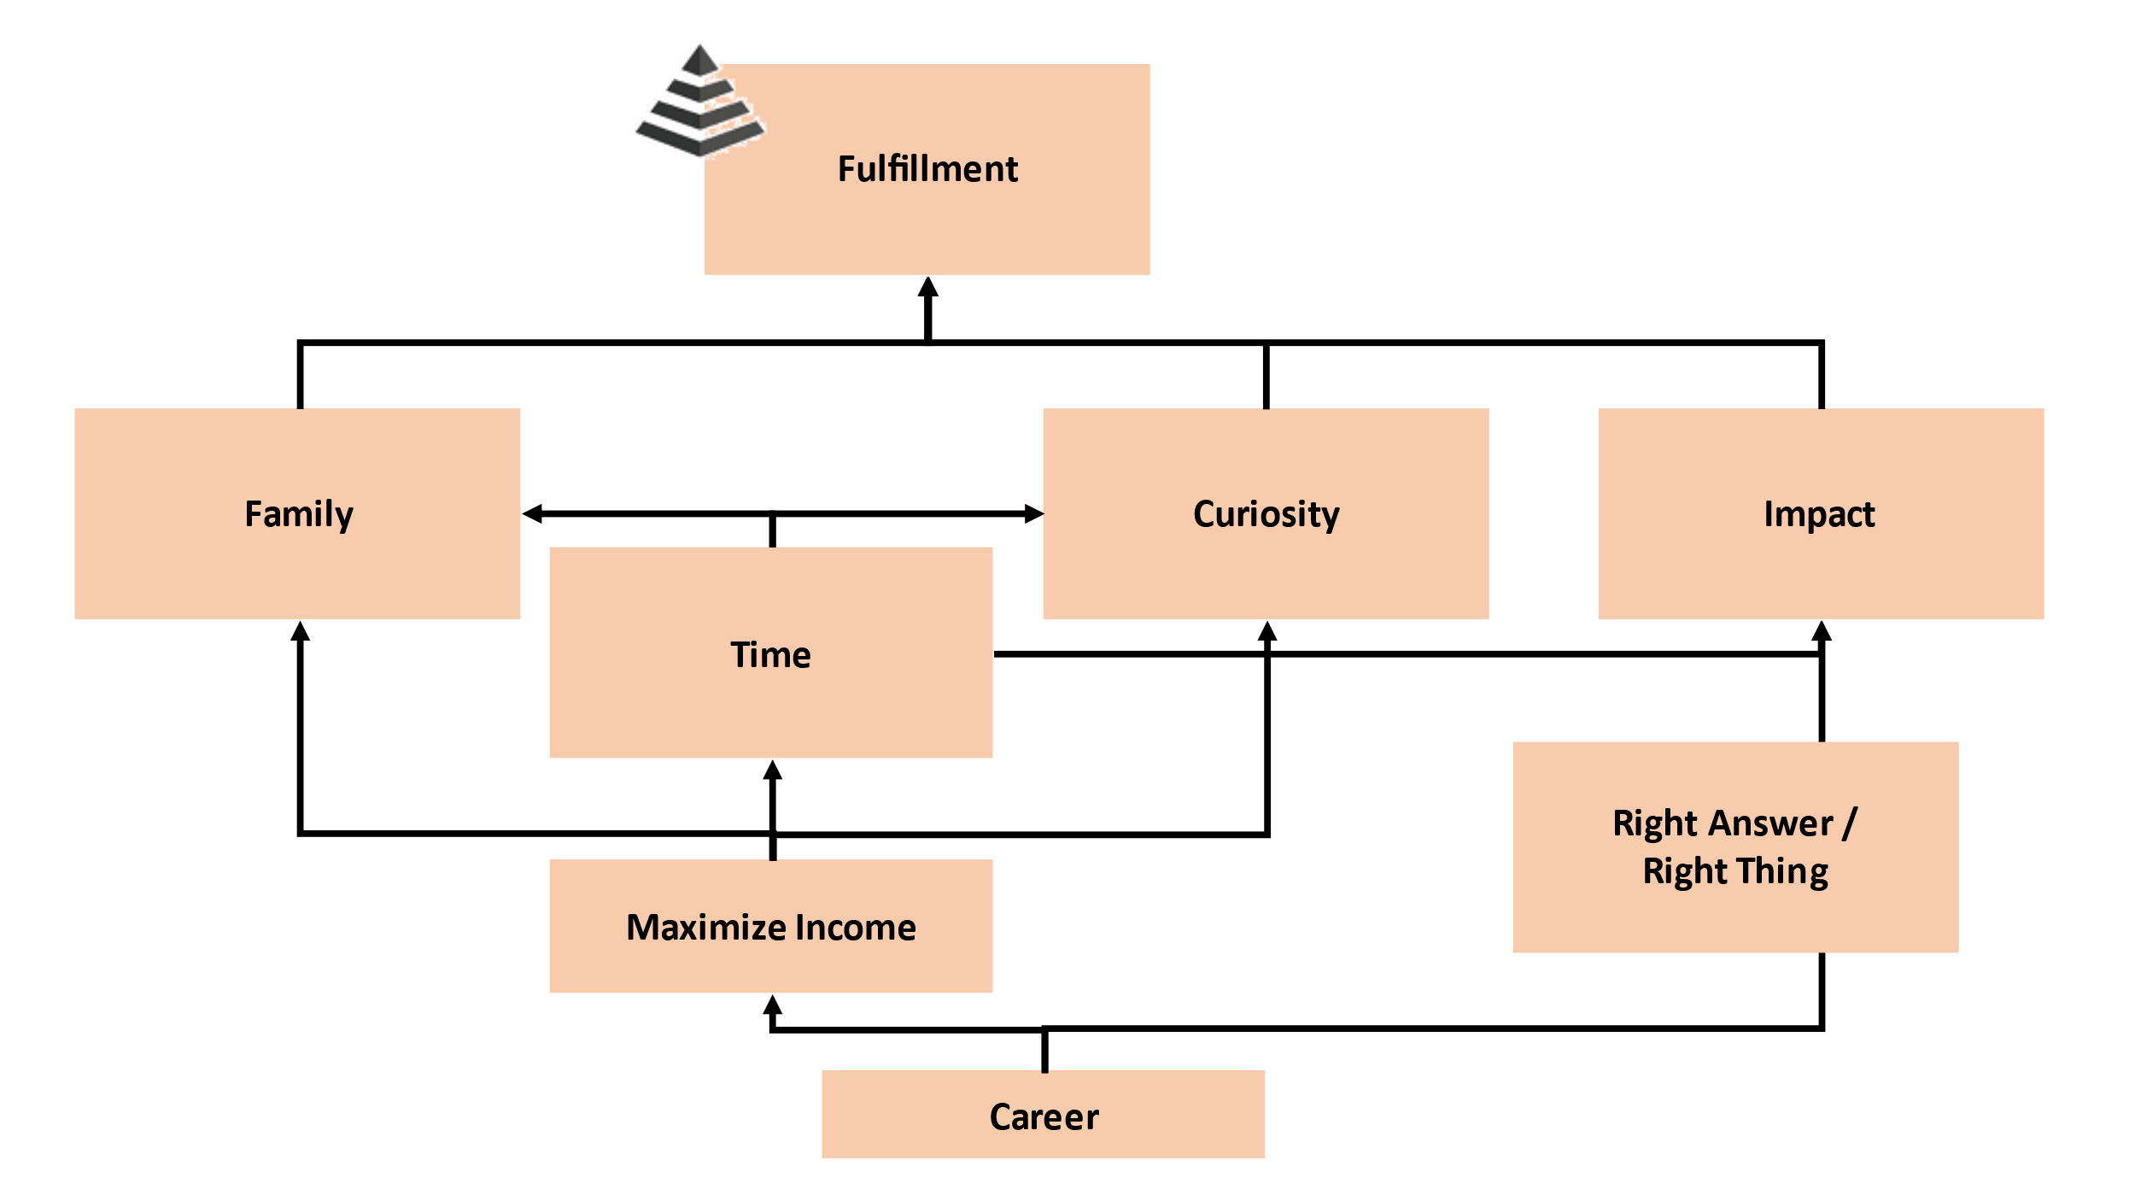
Davin Lewis

Slide 49
Bryan Maloney
Inner Harmony
Character
Fortitude
Creativity
Warmth
Reflection
Positivity
Thinking

Slide 51
Karena Mao
Happiness
Family
Flexibility
Health
Reliability
Passion
Success
Curiosity
Ability to
Implement & charge
Opportunity
Continues Leering

Slide 53
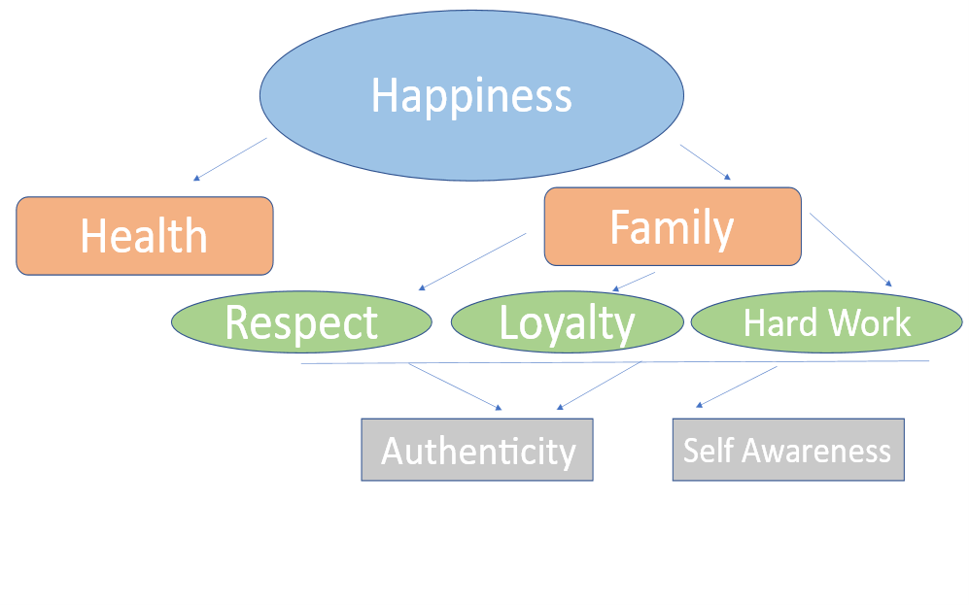
Dario Marcelli

Slide 55
Rupak Mehta

Slide 57
Pronay Mukherjee
Greatness
Make a Difference
Wisdom/ Facts
Admiration
Discipline
Grit
Discipline
Purpose

Slide 59
Jeremy Berke
Happiness
Character
Goodness
Curiosity
Wonder
Imagination
Fun
Enthusiasm

Slide 61
Ryohei Nishida
Growth
Family
Progress
Mindfulness
Equality
Innovation
Opportunities
……..

Slide 63
Nishanth Parameshwar Pavinkurve
Inner Peace
Security
Golden Rule
Spirituality
Strength
Humanity
Appreciation
Justice

Slide 65
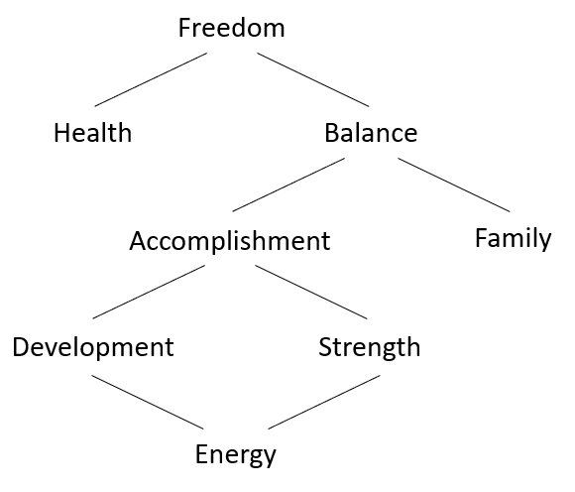
Cayla Plotch

Slide 67
David Reyes-Bastida

Slide 69
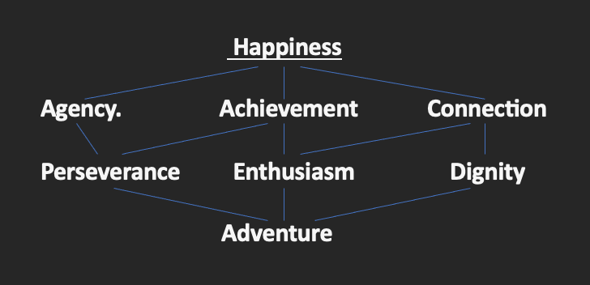
Samuel Ruddock

Slide 71
Tilottama Sen
Strength
Optimism
Dignity
Satisfaction
Fear of Mind
…………
………
………….
………

Slide 73
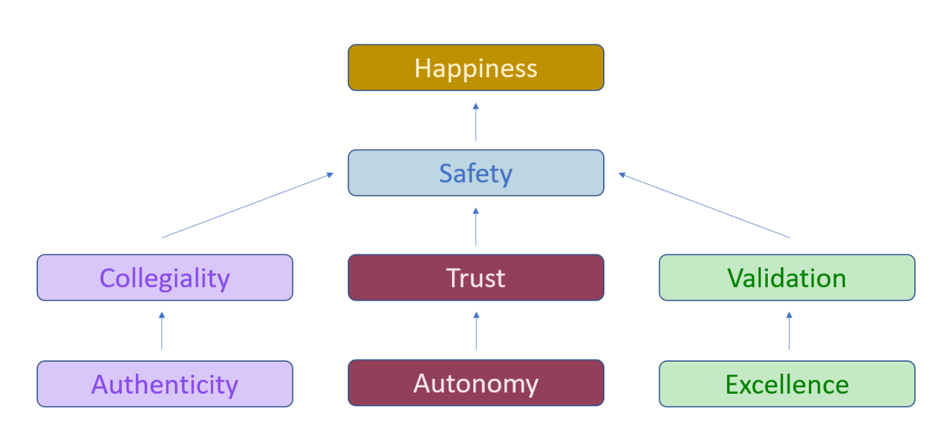
Ankita Shroff

Slide 75
Vitaliya Stankuviene
Harmony
Greatness
Family
Development
Safety
Autonomy
Inclusiveness
Financial Security

Slide 77
Diogo Vergniassi
Serenity
Health
Financial Stability
Understanding
Family
Grit
Professionalism
Thinking

Slide 79
Travis Vidic
Purpose
Reward
Heart
Love
Rigor
Ecstacy
Beauty
Justice

Slide 81
Linda Wang
Happiness
Improvement
Individuality
Independence
Appreciation
Conviction
Creativity
Playfulness

Slide 83
Jiaxin Zhang
Feeling Alive
Agency
Truth
Family
Wealth
Bravery
Fairness
Relationship
Dependability

Slide 85
Fulfillment
Legacy
Admiration
Make a Difference
Wealth
Wisdom
Confidence
Ambition
Kyle Sittmann

Slide 87
Morgan Bui
Joy
Financial Security
Relationship
Health
Engaged
Significance
Appreciation
Trustworthy

Slide 89
Sneha Banerjee
Feeling Alive
Health
Security
Creativity
Community
Opportunity
Presence
Comfort

